Slide 1
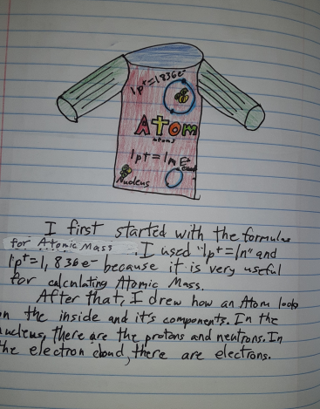
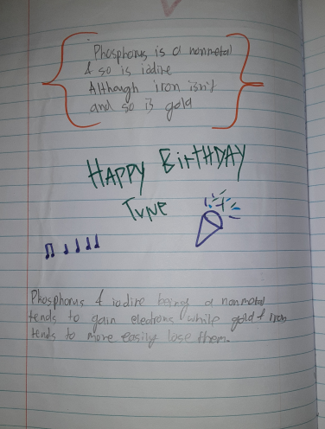
Mrs. Veneziale
7th Science & 7th grade Team Lead
Email: avenezia@houstonisd.org
https://sites.google.com/houstonisd.org/rogers7
ISN- Interactive Student notebook
Building our own textbook
Assessment Grade
Brain based learning strategies
Students take control of their own learning
Students may use on Quizzes & test
if Left ISN are completed
Need to keep for 8th grade STAAR
Supplies:
Composition Notebook
Scissors
Glue
Colored Pencils/markers

Slide 2
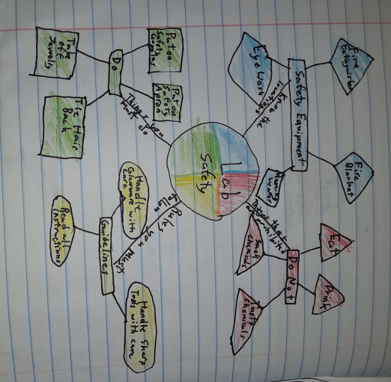
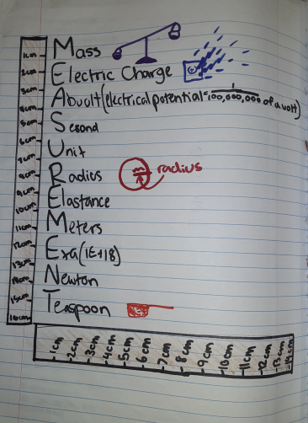
Scope & Sequence Accelerated Track
1st cycle- Chemistry
2nd cycle- Cells
3rd cycle - Cell cycle & Genetics
4th -6th cycle- Human Body Systems
Majority classwork will go into ISN
Majority Graded Assignment will be on Canvas
Project based Assessment
Quizzes at end of each Topic
Test or Project based assessment at end of each Unit.
Students can use ISN on Quizzes or Tests when Left sided is completed
Boom Cards- Until due date- May Redo without penalty
Canvas will be used for Announcements about upcoming projects, Quizzes & tests

Slide 3
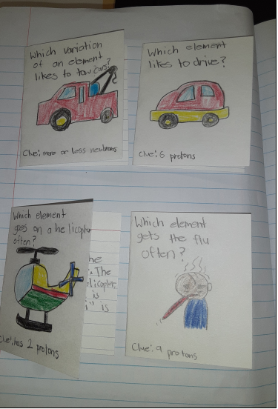
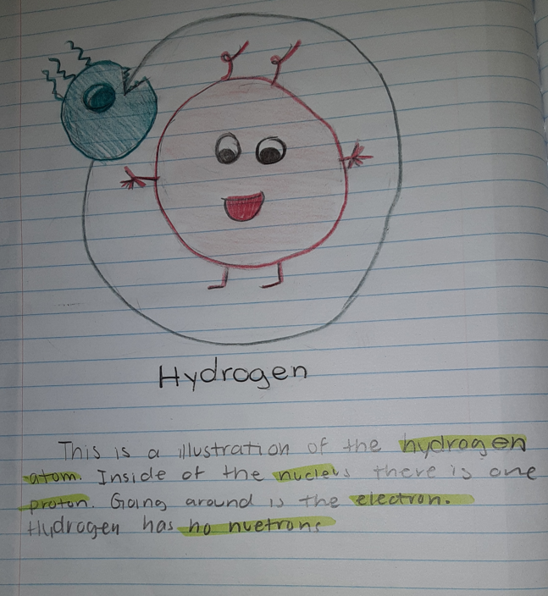
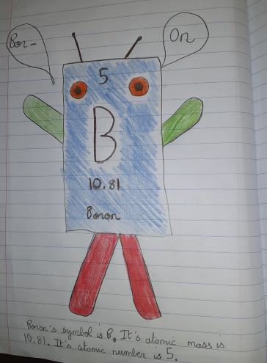
ISN- Interactive Student Notebook Examples

